Slide 1


Slide 2
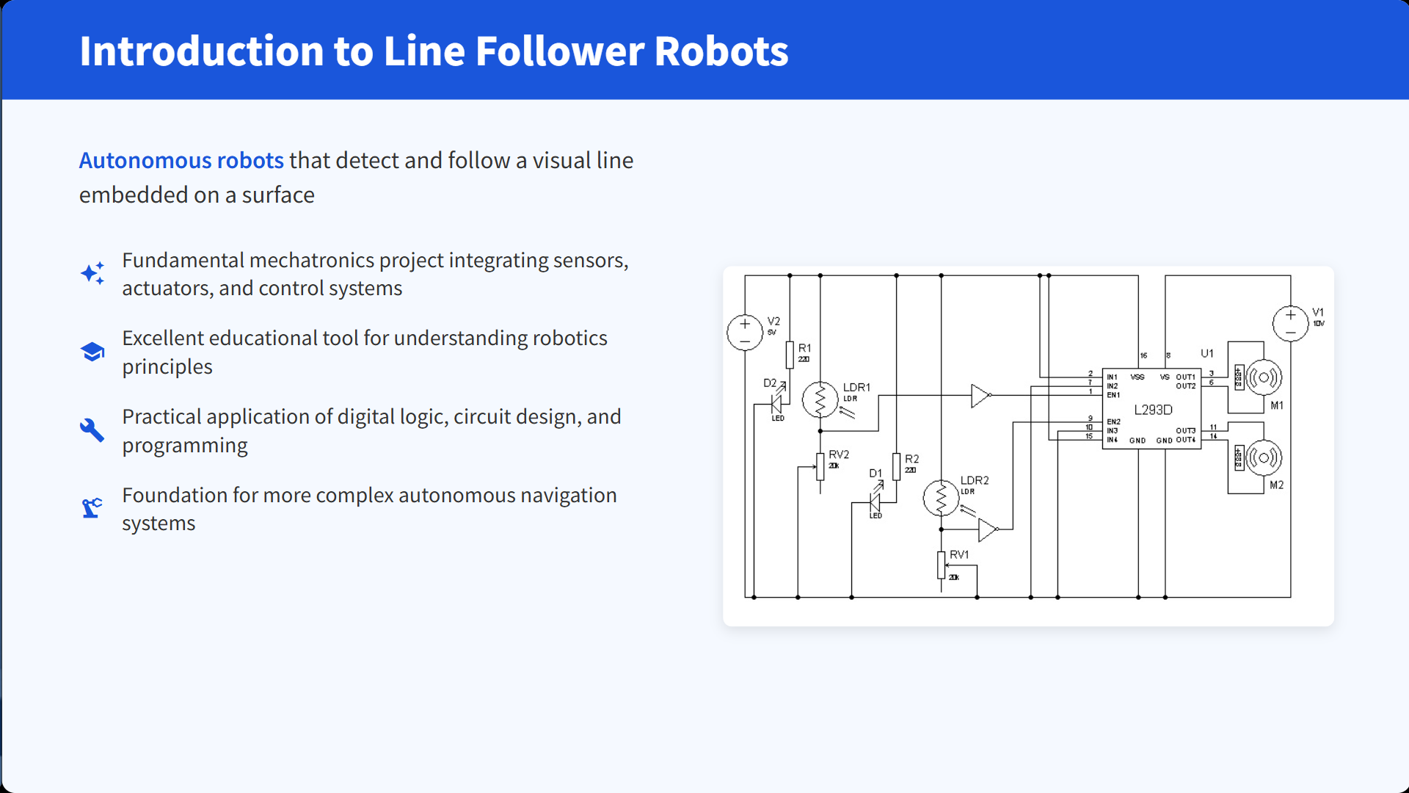

Slide 3
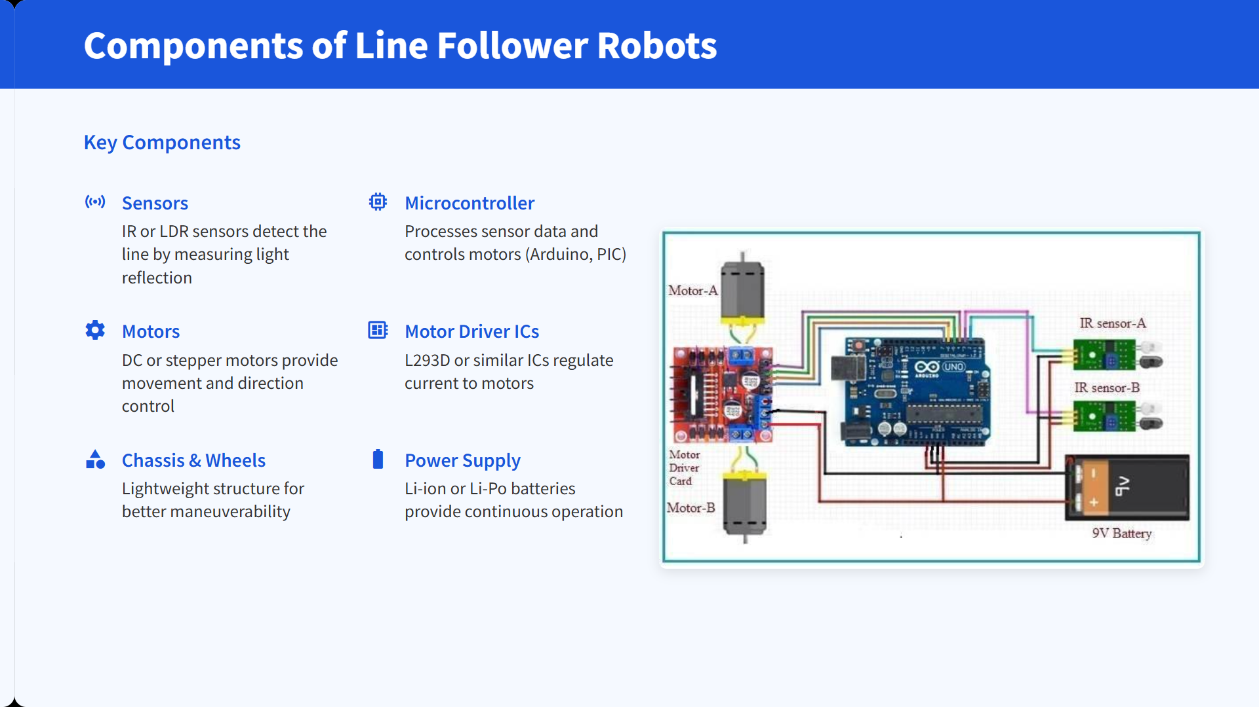

Slide 4
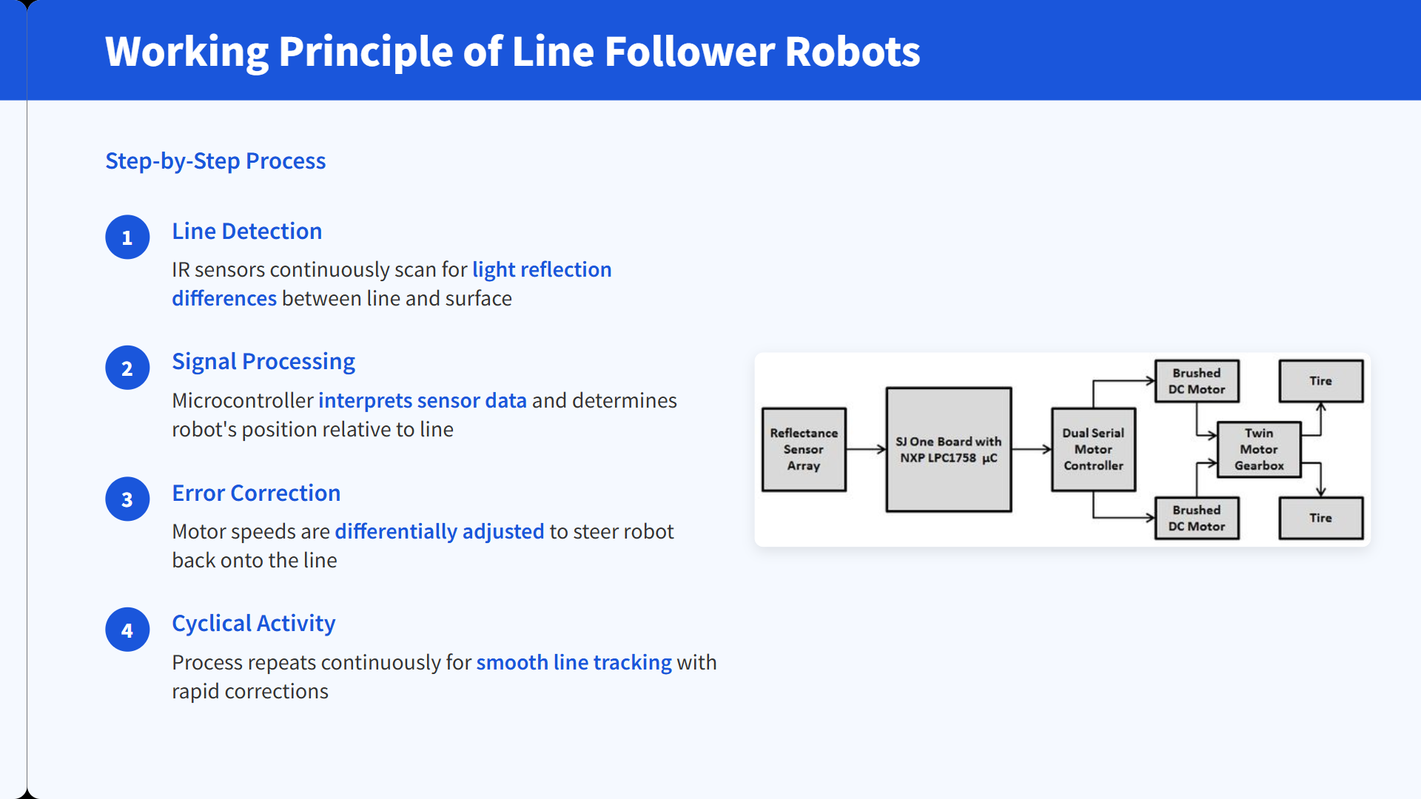

Slide 5
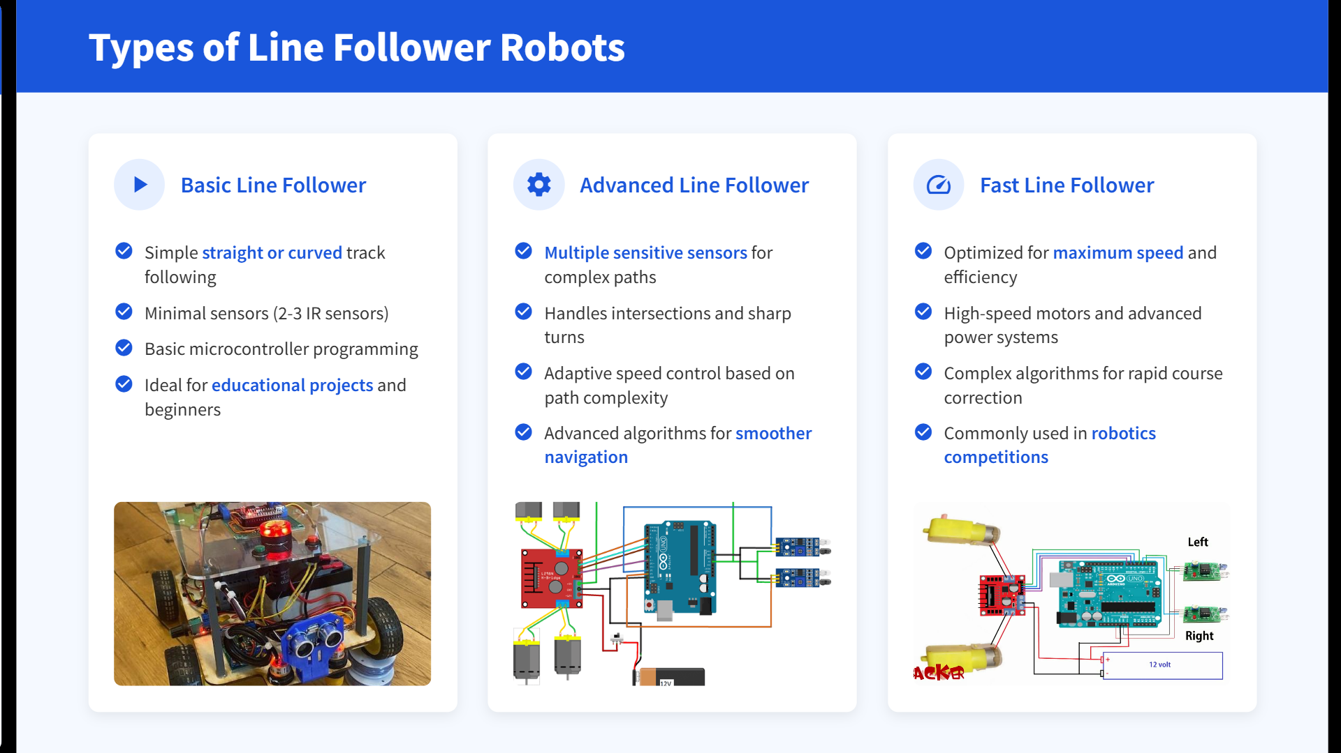

Slide 6
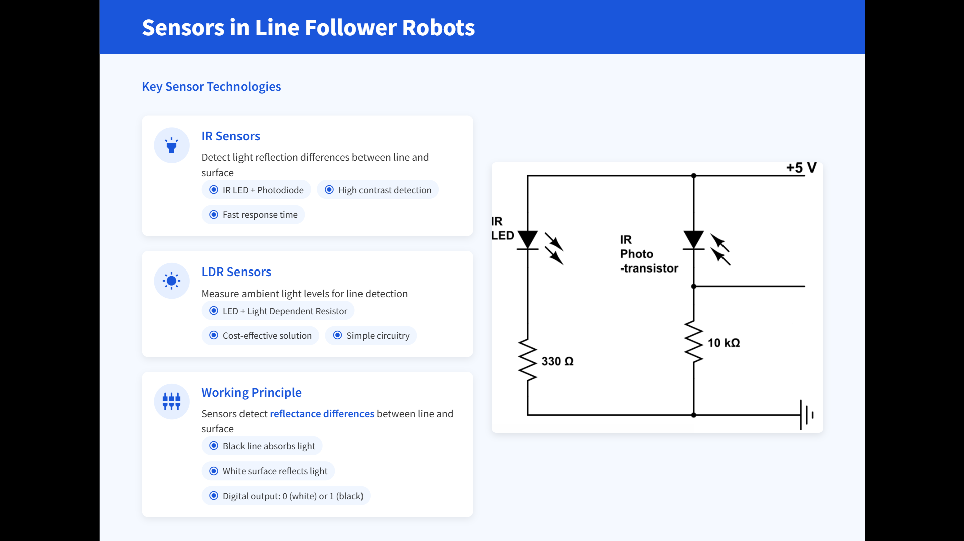

Slide 7
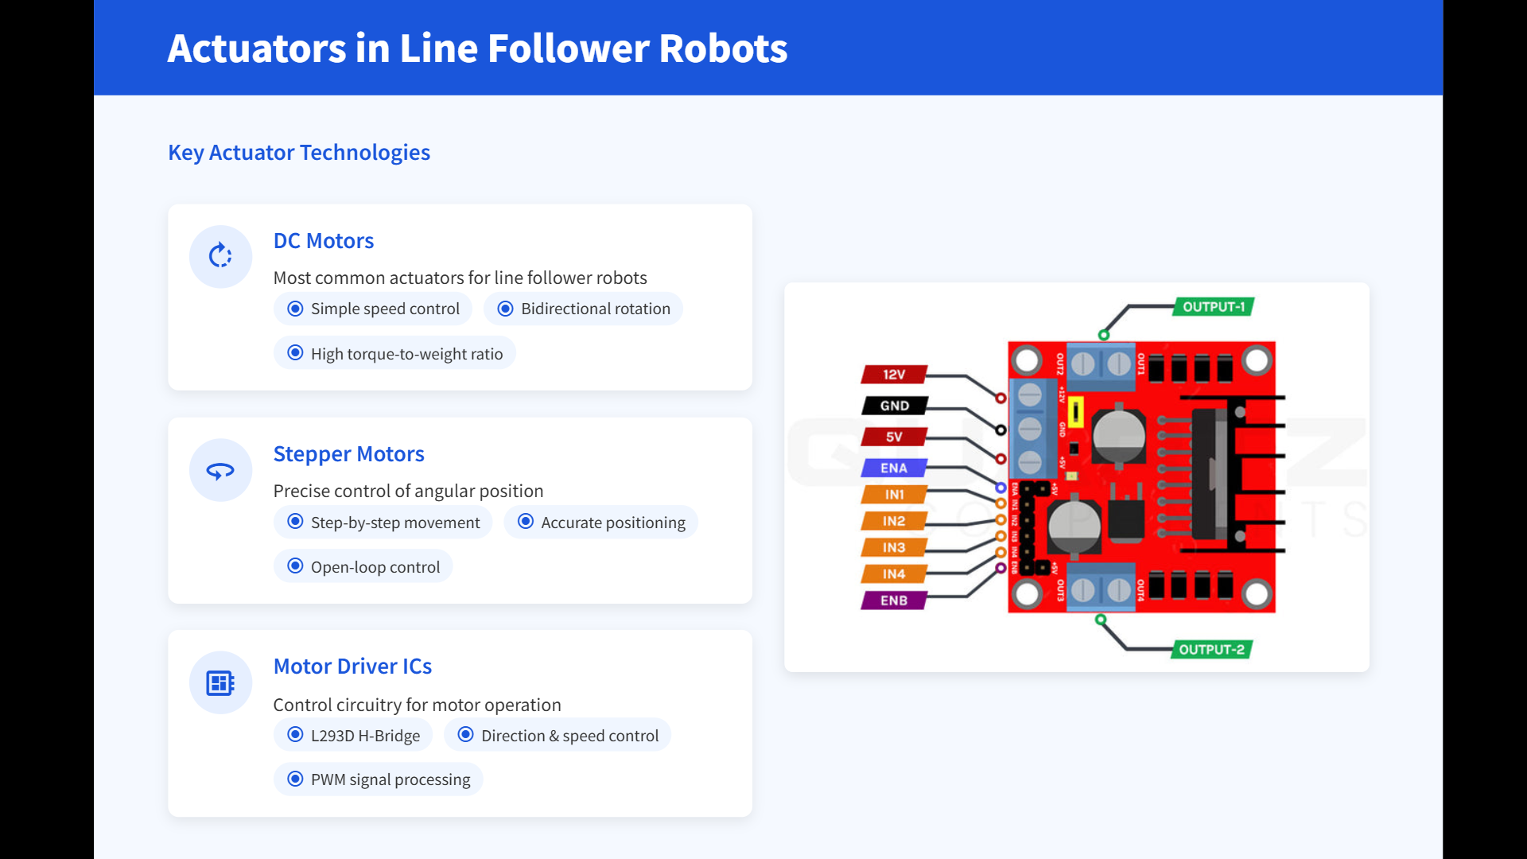

Slide 8
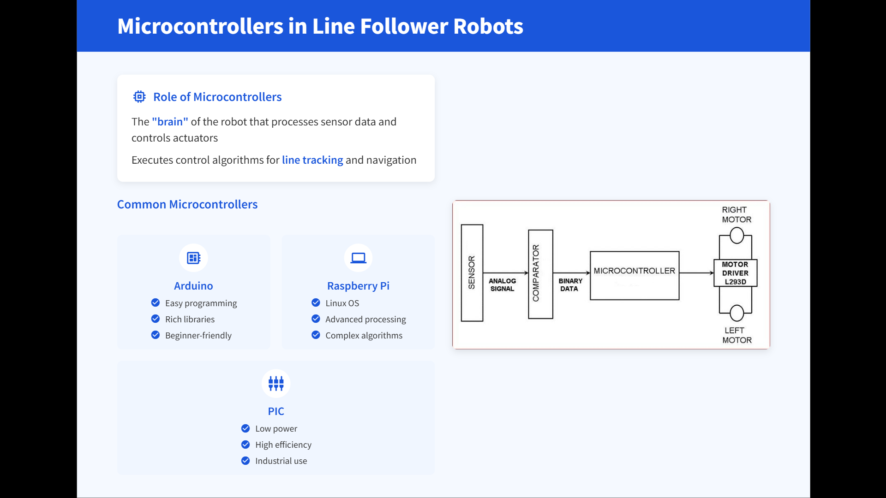

Slide 9
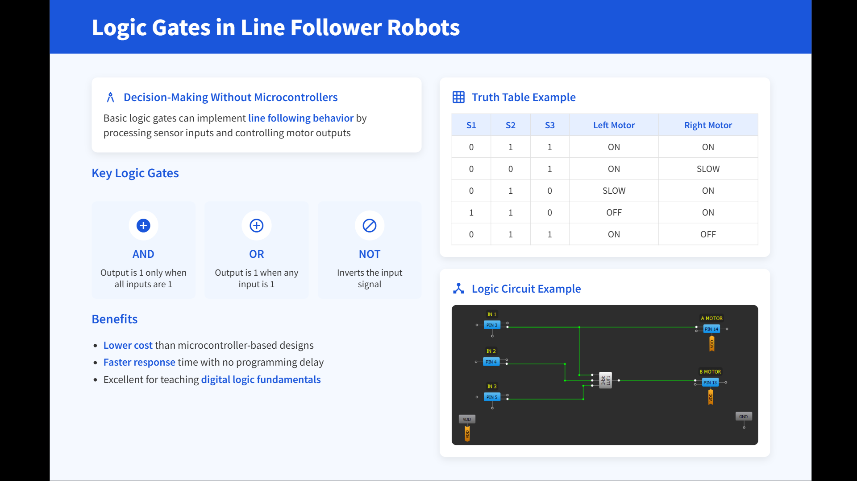

Slide 10
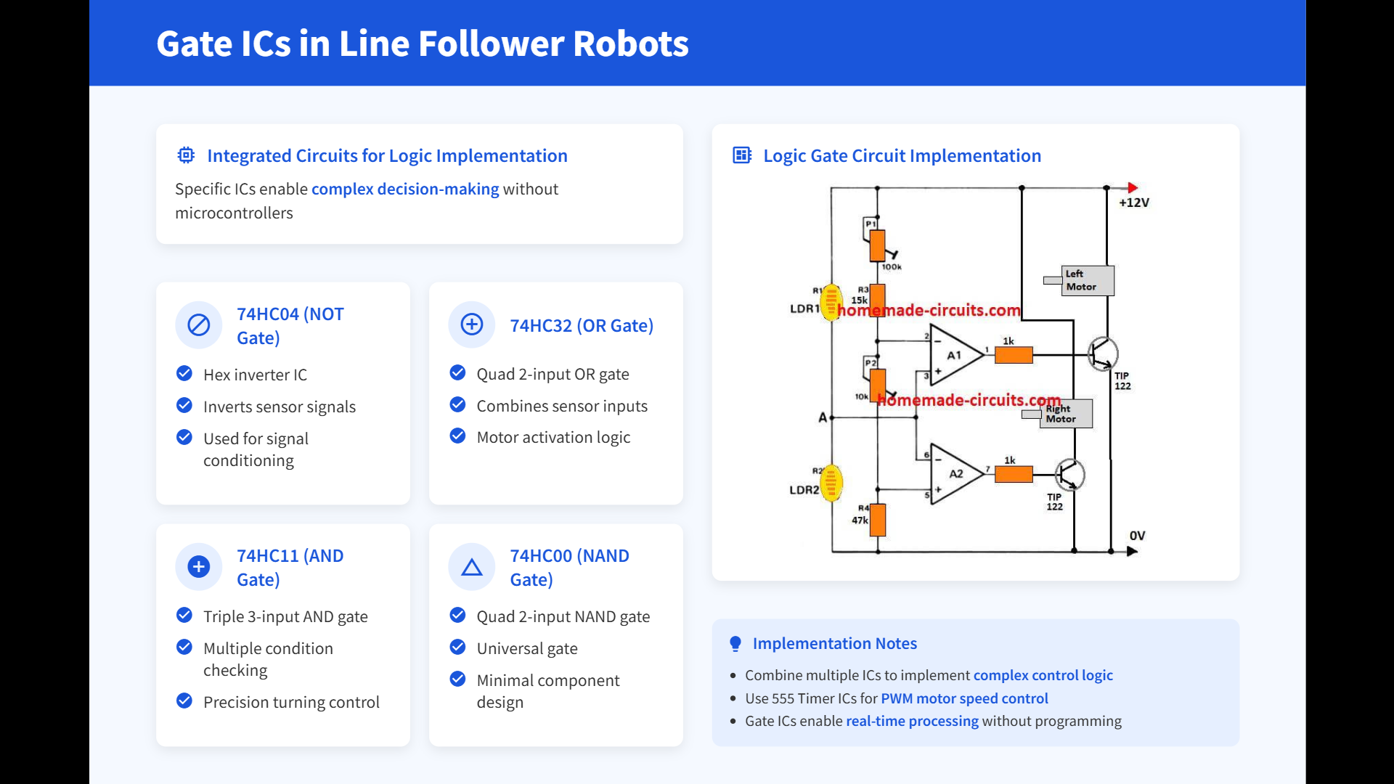

Slide 11
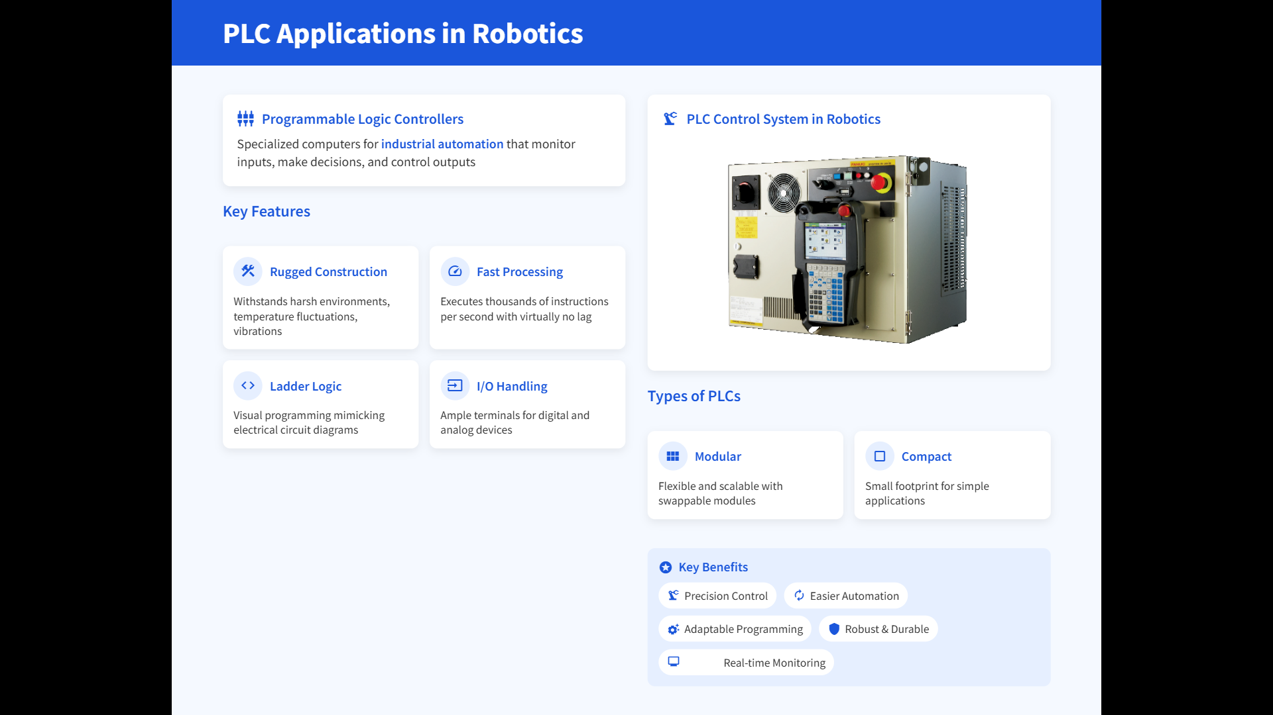

Slide 12
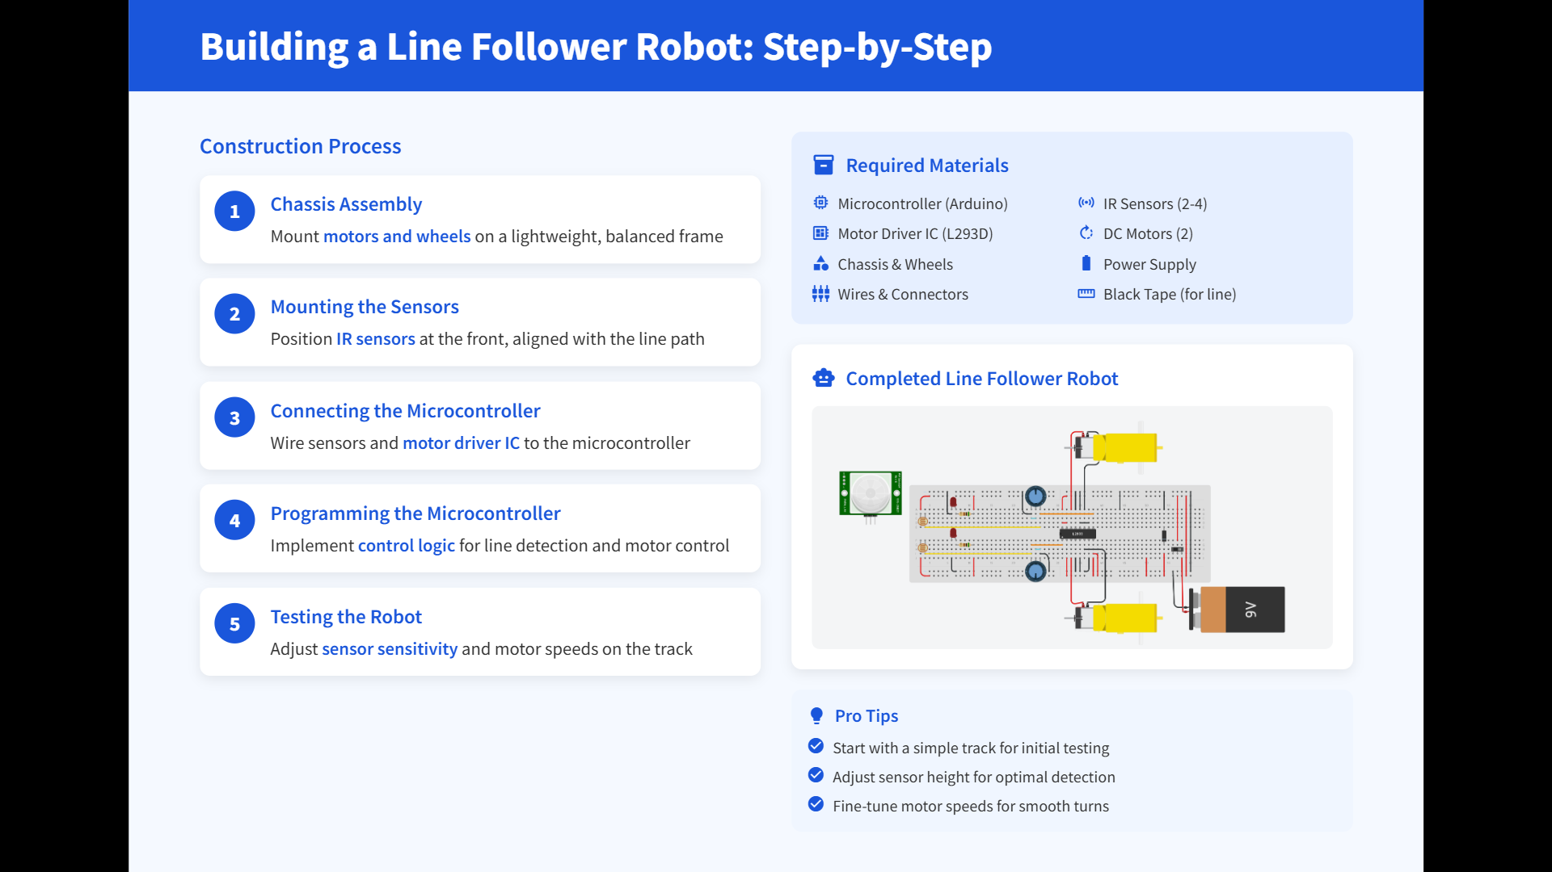

Slide 13
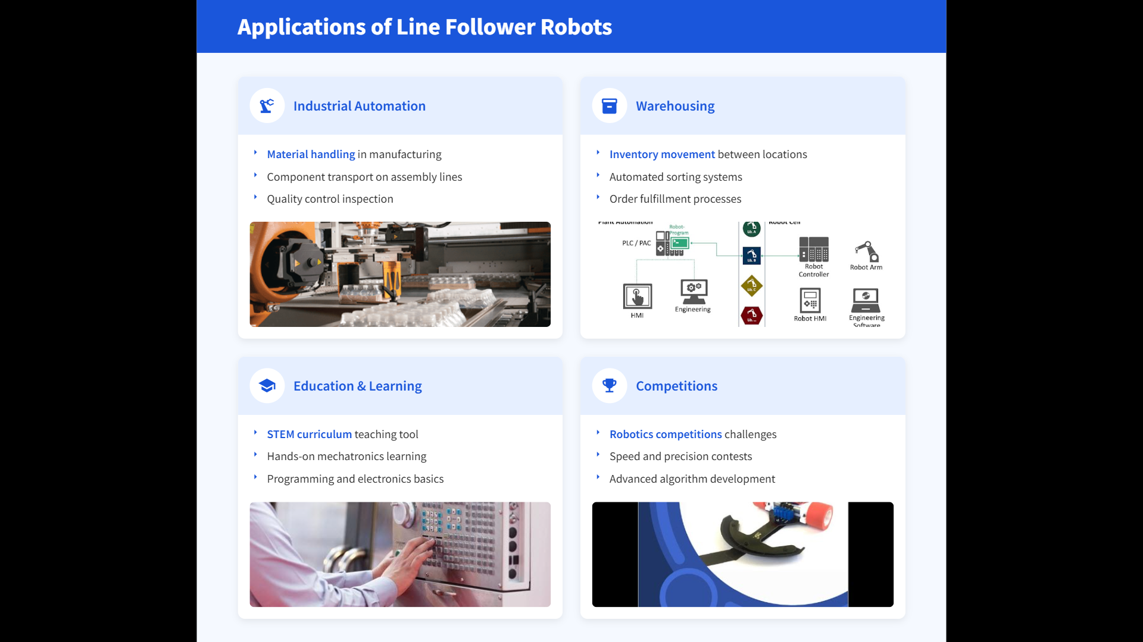

Slide 14
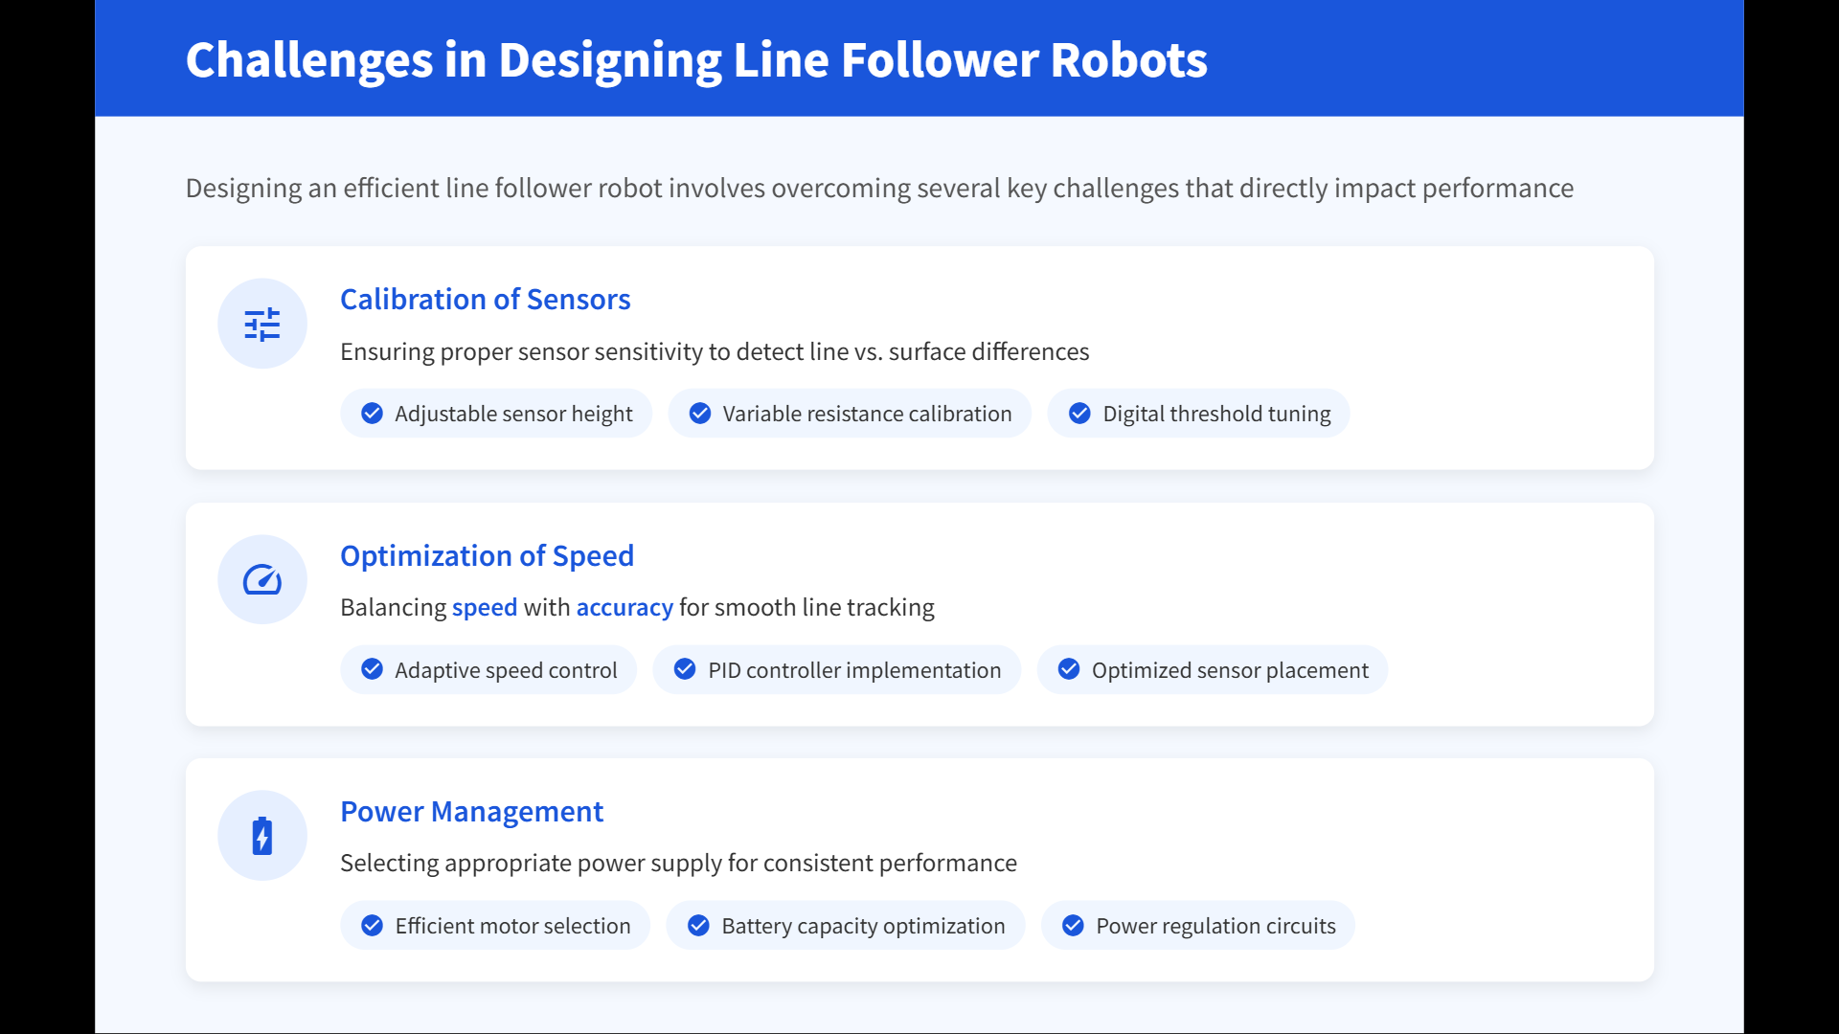

Slide 15


Slide 16

Thank You
By: John Botros 922230020
Omar Mohamed Abd El Salam 922230067
Amr Sherif 922230070
Mark Emad 922230075
Mohamed Magdy Ahmed 922230090
Mohamed Yasser 922230095
Abdelrahman Mohamed Saleh 922230057
To: Dr. Aya abdallah

